Slide 1
Machine Learning Based Long—Short Futures Strategies
XU Min 20460000 ZHANG LingXiao 20460000
CHEN Chong 20460529 WANG YiCheng 20460000

Slide 2
section 1
PROJECT INTRODUCTION

Slide 3
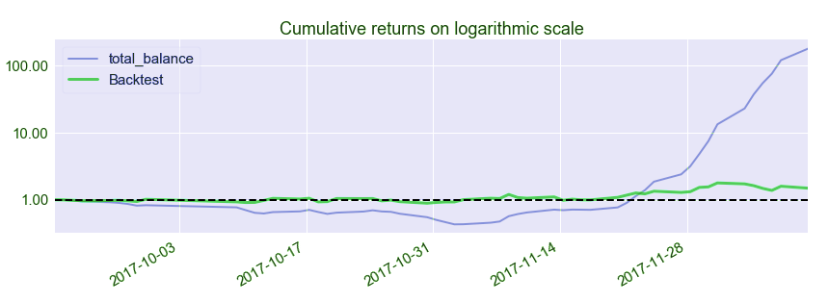

PROJECT INTRODUCTION
The main content of our project is a machine learning-based futures long-short arbitrage strategy. The goal we hope to achieve is that the cumulative return in 3 months reach 10%.

Slide 4
LIMITATIONS
Rebar and Coke
Plastic and Rubber
Soybean-oil，Vegetable -oil and Palm-oil
Usually valid for a short period of time
Conditions for opening and close positions
AND
Weights of funds on different types
Limited to certain types of futures
Relies heavily on people’s subject experience
The model is difficult to modify

Slide 5
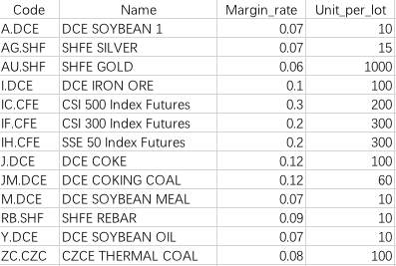



DATA INTRODUCTION
10 Commedity Futures
3 Index Futures
TRAINING
TEST
15th July 2017
15th Sep 2017
15th Dec 2017
MSBD5011 PRESENTATION

Slide 6
section 2
TRAINING MODELS

Slide 7
TRAINING STAGE
Rules
MACD，RSI，KD
MACD - Moving Average Convergence / Divergence
RSI - Relative Strength Index
KDJ - Stochastics Oscillator
Average price and Close price are both up
2015
Data Preproccessing
Build Indicators
Classification
Assign Labors
Generate Dataset
Average Price
Binary Indicator
Training Data
1：Buy
0：Not Buy
MSBD5011 PRESENTATION

Slide 8

TRANING STAGE
Average Price
Indicator Feature
Average Price
Label （1/0）
Training Set
Close Price
Model
Action:
1/0
MSBD5011 PRESENTATION

Slide 9
section 3
MODEL TEST

Slide 10
A Case study
New Data
Model
Output the rise probability of the future
Buy Largest 3 AND Sell Smallest 3
Buy
Sell
Probability>0.5 Calculate the quantity to buy
Probability<0.3
If hold this future, sell it out

Slide 11
Five steps
Model: Logistic Regression and SVM
Time span: how often the model to do a test
Cost rate: How many percent of the principal balance will be used in an action.(0.001~0.003)
Weight: The raise probability larger, the weight of the future larger. The quantity to buy is in direct proportion to the weight.

Slide 12
section 4
RESULT ANALYSIS

Slide 13
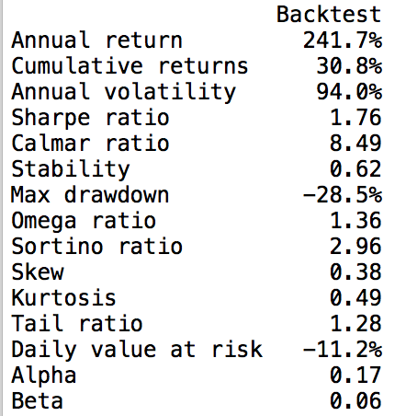
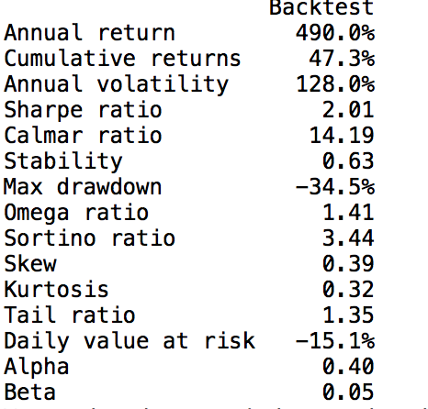
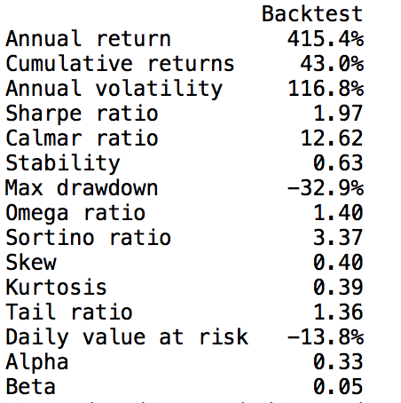
Logistic Regression
Sampling interval: 60 minutes
The proportion of the remaining principal for each operation : 0.003
The weight assigned to the selected three stocks: [1.2, 1.2, 0.6]
Lower limit of transaction: 2000000
Sampling interval: 45 minutes
The proportion of the remaining principal for each operation : 0.003
The weight assigned to the selected three stocks: [1.2, 1.2, 0.6]
Lower limit of transaction: 2000000
Sampling interval: 60 minutes
The proportion of the remaining principal for each operation : 0.003
The weight assigned to the selected three stocks: [1.5, 1.2, 0.6]
Lower limit of transaction: 2000000

Slide 14
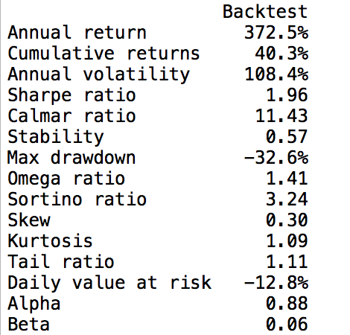
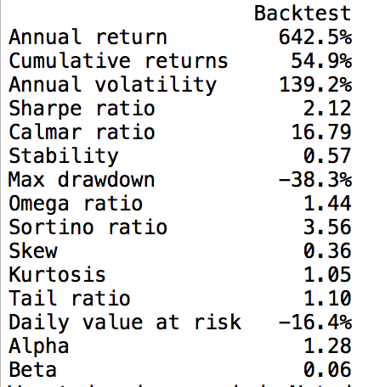
SVM
Sampling interval: 60 minutes
The proportion of the remaining principal for each operation : 0.001
The weight assigned to the selected three stocks: [1.2, 1.2, 0.6]
Lower limit of transaction: 4000000
Sampling interval: 45 minutes
The proportion of the remaining principal for each operation : 0.001
The weight assigned to the selected three stocks: [1.2, 1.0, 0.6]
Lower limit of transaction: 4000000
Sampling interval: 45 minutes
The proportion of the remaining principal for each operation : 0.003
The weight assigned to the selected three stocks: [1.2, 1.0, 0.6]
Lower limit of transaction: 4000000
MSBD5011 PRESENTATION

